Slide 1
第二章 高级流水技术
第一节 乱序流动中的数据相关
第二节 循环展开技术LOOP UNROLLING
第三节 重命名技术
第四节 动态调度技术
Scoreboard
Tomasulo Algorithm

Slide 2
2.1 乱序流动中的数据相关
1. 顺序流动与乱序流动
顺序流动方式：任务按顺序流入流水线,也按顺序流出流水线
乱序(Out of order)流动方式：指令流出流水线的顺序与流入流水线的顺序不同。又称为错序流动方式、无序流动方式、异步流动方式等。

Slide 3
2. 乱序流动中的数据相关
在乱序流动方式中，可能发生三种数据相关
写写相关
k： LOAD F1, A ;F1←（A） 写读相关
k+1：FADD F2, F1 ;F2←（F2）+（F1）
k+2：FMUL F1, F3 ;F1←（F1）×（F3）
k+3：STORE F1, B ;B←（F1）读写相关
(1)写读相关：指令k与指令k+1之间关于F1的相关，又称为数据相关、先写后读相关、流相关、WR相关、RAW相关等。

Slide 4
(2)读写相关：指令k+1与指令k+2之间关于F1的相关，变量名相关、先读后写相关、反相关、RW相关、WAR相关等。
(3)写写相关：指令k与指令k+2左边的F1之间的相关关系称为：输出相关、写写相关、WW相关、WAW相关或写后再写相关等。
有时把相关称为“冒险”(hazard)、“竟争” (competition)等。
在程序执行过程中，只有避免相关，执行结果才是正确的。

Slide 5
2.2 循环展开技术（loop unrolling)
指令级并行（ILP）研究的是一个基本程序块中指令序列之间存在的并行性。
最常见的基本块是循环体
开发循环级并行的最基本技术：
循环展开技术
重命名技术

Slide 6
静态指令调度:由优化的编译程序来完成，其基本思想是重排指令序列，拉开具有数据相关的有关指令间的距离。
例：下面程序完成(A*B)+(C*D)的运算
LOAD R1,M(A)
LOAD R2,M(B)
MUL R5,R1,R2
LOAD R3,M(C)
LOAD R4,M(D)
ADD R2,R3,R4
ADD R2,R2,R5
LOAD R1,M(A)
LOAD R2,M(B)
LOAD R3,M(C)
LOAD R4,M(D)
MUL R5,R1,R2
ADD R2,R3,R4
ADD R2,R2,R5

Slide 7
Unrolling
Pipeline CPI= ideal pipeline CPI+RAW stalls + WAR stalls + WAW stalls + Control stalls
LD F6, 34(R2)
LD F2, 45(R3)
MULTD F0,F2,F4
SUBD F8,F6,F2
DIVD F10,F0, F6
ADDD F6, F8, F2
RAW（WR先写后读)
  Basic scheduling
  Scoreboarding
WAR(RW先读后写)
  Tomasulo’s algorithm
WAW(WW写写)
  Tomasulo’s algorithm
Control Hazard
  Unrolling
  Dynamic branch prediction
  Speculation

Slide 8
Instruction Latencies
Instruction Instruction Latency in
producing result using result clock cycles
FP ALU op Another FP ALU op 3
FP ALU op Store double 2
Load double FP ALU op 1
Load double Store double 0
Integer op Integer op 0

Slide 9
Simple Loop and assembler
for (i=1; i<=1000; i++)
x(i) = x(i) + s;
Each iteration of the loop can overlap with any other iteration, giving the opportunity to exploit loop-level parallelism.
Loop: LD F0,0(R1) ;F0=vector element
ADDD F4,F0,F2 ;add scalar from F2
SD 0(R1),F4 ;store result
SUBI R1,R1,8 ;decrement pointer 8B (DW)
BNEZ R1,Loop ;branch R1!=zero
NOP ;delayed branch slot

Slide 10
FP Loop: Where are the Hazards?
Loop: LD F0,0(R1) ;F0=vector element
ADDD F4,F0,F2 ;add scalar from F2
SD 0(R1),F4 ;store result
SUBI R1,R1,8 ;decrement pointer 8B (DW)
BNEZ R1,Loop ;branch R1!=zero
NOP ;delayed branch slot
Instruction Instruction Latency in
producing result using result clock cycles
FP ALU op Another FP ALU op 3
FP ALU op Store double 2
Load double FP ALU op 1
Load double Store double 0
Integer op Integer op 0
Where are the stalls?

Slide 11
FP Loop Hazards
Loop: LD F0,0(R1) ;F0=vector element
ADDD F4,F0,F2 ;add scalar in F2
SD 0(R1),F4 ;store result
SUBI R1,R1,8 ;decrement pointer 8B (DW)
BNEZ R1,Loop ;branch R1!=zero
NOP ;delayed branch slot
Instruction Instruction Latency in
producing result using result clock cycles
FP ALU op Another FP ALU op 3
FP ALU op Store double 2
Load double FP ALU op 1
Load double Store double 0
Integer op Integer op 0

Slide 12
FP Loop Showing Stalls
1 Loop: LD F0,0(R1) ;F0=vector element
2 stall
3 ADDD F4,F0,F2 ;add scalar in F2
4 stall
5 stall
6 SD 0(R1),F4 ;store result
7 SUBI R1,R1,#8 ;decrement pointer 8B (DW)
8 stall
9 BNEZ R1,Loop ;branch R1!=zero
10 stall ;delayed branch slot
Instruction Instruction Latency in
producing result using result clock cycles
FP ALU op Another FP ALU op 3
FP ALU op Store double 2
Load double FP ALU op 1
10 clocks: Rewrite code to minimize stalls?

Slide 13
Revised FP Loop Minimizing Stalls
1 Loop: LD F0,0(R1)
2 stall
3 ADDD F4,F0,F2
4 SUBI R1,R1,#8
5 stall
6 BNEZ R1,Loop ;delayed branch
7 SD 8(R1),F4 ;altered when move past SUBI
Can do it better
Swap BNEZ and SD by changing address of SD
Instruction Instruction Latency in
producing result using result clock cycles
FP ALU op Another FP ALU op 3
FP ALU op Store double 2
Load double FP ALU op 1
7 clocks: Unroll loop 4 times code to make faster?
Notes:
3 clocks doing work, 3 overhead (stall, branch, sub)

Slide 14
Revised FP Loop Minimizing Stalls
1 Loop: LD F0,0(R1)
2 SUBI R1,R1,#8
3 ADDD F4,F0,F2
4 stall
5 BNEZ R1,Loop ;delayed branch
6 SD 8(R1),F4 ;altered when move past SUBI
Swap BNEZ and SD by changing address of SD
Instruction Instruction Latency in
producing result using result clock cycles
FP ALU op Another FP ALU op 3
FP ALU op Store double 2
Load double FP ALU op 1
6 clocks: Unroll loop 4 times code to make faster?

Slide 15
Unroll Loop Four Times (straightforward way)
1 Loop: LD F0,0(R1)
2 ADDD F4,F0,F2
3 SD 0(R1),F4 ;drop SUBI & BNEZ
4 LD F6,-8(R1)
5 ADDD F8,F6,F2
6 SD -8(R1),F8 ;drop SUBI & BNEZ
7 LD F10,-16(R1)
8 ADDD F12,F10,F2
9 SD -16(R1),F12 ;drop SUBI & BNEZ
10 LD F14,-24(R1)
11 ADDD F16,F14,F2
12 SD -24(R1),F16
13 SUBI R1,R1,#32 ;alter to 4*8
14 BNEZ R1,LOOP
14 + 4 x (1+2) +1+1= 28 clock cycles, or 7 per iteration. Assumes R1 is multiple of 4
Rewrite loop to minimize stalls?

Slide 16
Unrolled Loop That Minimizes Stalls
1 Loop: LD F0,0(R1)
2 LD F6,-8(R1)
3 LD F10,-16(R1)
4 LD F14,-24(R1)
5 ADDD F4,F0,F2
6 ADDD F8,F6,F2
7 ADDD F12,F10,F2
8 ADDD F16,F14,F2
9 SD 0(R1),F4
10 SD -8(R1),F8
11 SUBI R1,R1,#32
12 SD -16(R1),F12
13 BNEZ R1,LOOP
14 SD 8(R1),F16 ; 8-32 = -24
14 clock cycles, or 3.5 per iteration
When safe to move instructions?
What assumptions made when moved code?
  OK to move store past SUBI even though changes register
  OK to move loads before stores: get right data?
  When is it safe for compiler to do such changes?

Slide 17
Summary of Loop Unrolling Example
Determine that it was legal to move the SD after the SUBI and BNEZ, and find the amount to adjust the SD offset.
Determine that unrolling the loop would be useful by finding that the loop iterations were independent, except for the loop maintenance code.
Use different registers to avoid unnecessary constraints that would be forced by using the same registers for different computations.
Eliminate the extra tests and branches and adjust the loop maintenance code.
Determine that the loads and stores in the unrolled loop can be interchanged by observing that the loads and stores from different iterations are independent. This requires analyzing the memory addresses and finding that they do not refer to the same address.
Schedule the code, preserving any dependences needed to yield the same result as the original code.

Slide 18
将上述例子中的循环展开，复制5个副本，在对展开后的指令序列不调度和调度两种情况下，分析代码的性能
1 Loop: LD F0,0(R1)
2 ADDD F4,F0,F2
3 SD 0(R1),F4 ;drop SUBI & BNEZ
4 LD F6,-8(R1)
5 ADDD F8,F6,F2
6 SD -8(R1),F8 ;drop SUBI & BNEZ
7 LD F10,-16(R1)
8 ADDD F12,F10,F2
9 SD -16(R1),F12 ;drop SUBI & BNEZ
10 LD F14,-24(R1)
11 ADDD F16,F14,F2
12 SD -24(R1),F16
13 LD F18,-32(R1)
14 ADDD F20,F18,F2
15 SD -32(R1),F20
16 SUBI R1,R1,#40 ;
17 BNEZ R1,LOOP

Slide 19
1 Loop:LD F0,0(R1)
2 LD F6,-8(R1)
3 LD F10,-16(R1)
4 LD F14,-24(R1)
5 LD F18,-32(R1)
6 ADDD F4,F0,F2
7 ADDD F8,F6,F2
8 ADDD F12,F10,F2
9 ADDD F16,F14,F2
10 ADDD F20,F18,F2
11 SD 0(R1),F4
12 SD -8(R1),F8
13 SD -16(R1),F12
14 SUBI R1,R1,#40
15 SD -24(R1),F12
16 BNEZ R1,LOOP
17 SD 8(R1),F20 ;

Slide 20
2.3 重命名技术
Another kind of dependence called name dependence:
two instructions use same name (register or memory location) but don’t exchange data
Antidependence (WAR if a hazard for HW)
  Instruction j writes a register or memory location that instruction i reads from and instruction i is executed first
  i: A=B / C
  …
  j: B=D + E
Output dependence (WAW if a hazard for HW)
  Instruction i and instruction j write the same register or memory location; ordering between instructions must be preserved.

Slide 21
Where are the name dependencies?
1 Loop: LD F0,0(R1)
2 ADDD F4,F0,F2
3 SD 0(R1),F4 ;drop SUBI & BNEZ
4 LD F0,-8(R1)
2 ADDD F4,F0,F2
3 SD -8(R1),F4 ;drop SUBI & BNEZ
7 LD F0,-16(R1)
8 ADDD F4,F0,F2
9 SD -16(R1),F4 ;drop SUBI & BNEZ
10 LD F0,-24(R1)
11 ADDD F4,F0,F2
12 SD -24(R1),F4
13 SUBI R1,R1,#32 ;alter to 4*8
14 BNEZ R1,LOOP
15 NOP
How can remove them?
Notes:
LD F0 to output to next LD F0
ADD F0 input to LD F0

Slide 22
Where are the name dependencies?
1 Loop: LD F0,0(R1)
2 ADDD F4,F0,F2
3 SD 0(R1),F4 ;drop SUBI & BNEZ
4 LD F6,-8(R1)
5 ADDD F8,F6,F2
6 SD -8(R1),F8 ;drop SUBI & BNEZ
7 LD F10,-16(R1)
8 ADDD F12,F10,F2
9 SD -16(R1),F12 ;drop SUBI & BNEZ
10 LD F14,-24(R1)
11 ADDD F16,F14,F2
12 SD -24(R1),F16
13 SUBI R1,R1,#32 ;alter to 4*8
14 BNEZ R1,LOOP
15 NOP
Called “register renaming”

Slide 23
2.4动态调度技术
Why in HW at run time?
  Works when can’t know real dependence at compile time
  Compiler simpler
  Code for one machine runs well on another
Key idea: Allow instructions behind stall to proceed
DIVD F0,F2,F4
ADDD F10,F0,F8
SUBD F12,F8,F14
  Enables out-of-order execution => out-of-order completion
  ID stage checked both for structuralScoreboard dates to CDC 6600 in 1963

Slide 24
HW Schemes: Instruction Parallelism
Out-of-order execution divides ID stage:
  1. Issue—decode instructions, check for structural hazards
  2. Read operands—wait until no data hazards, then read operands
Scoreboards allow instruction to execute whenever 1 & 2 hold, not waiting for prior instructions
CDC 6600: In order issue, out of order execution, out of order commit ( also called completion)

Slide 25
Scoreboard Implications
Out-of-order completion => WAR, WAW hazards?
Solutions for WAR
  Queue both the operation and copies of its operands
  Read registers only during Read Operands stage
For WAW, must detect hazard: stall until other completes
Need to have multiple instructions in execution phase => multiple execution units or pipelined execution units
Scoreboard keeps track of dependencies, state or operations
Scoreboard replaces ID, EX, WB with 4 stages
A=B*C
B=D+E

Slide 26
Four Stages of Scoreboard Control
1. Issue—decode instructions & check for structural hazards (ID1)
  If a functional unit for the instruction is free and no other active instruction has the same destination register (WAW), the scoreboard issues the instruction to the functional unit and updates its internal data structure. If a structural or WAW hazard exists, then the instruction issue stalls, and no further instructions will issue until these hazards are cleared.
2. Read operands—wait until no data hazards, then read operands (ID2)
  A source operand is available if no earlier issued active instruction is going to write it, or if the register containing the operand is being written by a currently active functional unit. When the source operands are available, the scoreboard tells the functional unit to proceed to read the operands from the registers and begin execution. The scoreboard resolves RAW hazards dynamically in this step, and instructions may be sent into execution out of order.

Slide 27
Four Stages of Scoreboard Control
3. Execution—operate on operands (EX)
  The functional unit begins execution upon receiving operands. When the result is ready, it notifies the scoreboard that it has completed execution.
4. Write result—finish execution (WB)
  Once the scoreboard is aware that the functional unit has completed execution, the scoreboard checks for WAR hazards. If none, it writes results. If WAR, then it stalls the instruction.
  Example:
  DIVD F0,F2,F4
  ADDD F10,F0,F8
  SUBD F8,F8,F14
  CDC 6600 scoreboard would stall SUBD until ADDD reads operands

Slide 28
Three Parts of the Scoreboard
1. Instruction status—which of 4 steps the instruction is in
2. Functional unit status—Indicates the state of the functional unit (FU). 9 fields for each functional unit
Busy—Indicates whether the unit is busy or not
Op—Operation to perform in the unit (e.g., + or –)
Fi—Destination register
Fj, Fk—Source-register numbers
Qj, Qk—Functional units producing source registers Fj, Fk
Rj, Rk—Flags indicating when Fj, Fk are ready
3. Register result status—Indicates which functional unit will write each register, if one exists. Blank when no pending instructions will write that register
Notes:
What you might have thought
1. 4 stages of instruction executino
2.Status of FU: Normal things to keep track of (RAW & structura for busyl):
Fi from instruction format of the mahine (Fi is dest)
Add unit can Add or Sub
Rj, Rk - status of registers (Yes means ready)
Qj,Qk - If a no in Rj, Rk, means waiting for a FU to write result; Qj, Qk means wihch FU waiting for it
3.Status of register result (WAW &WAR)s:
which FU is going to write into registers
Scoreboard on 6600 = size of FU
6.7, 6.8, 6.9, 6.12, 6.13, 6.16, 6.17
FU latencies: Add 2, Mult 10, Div 40 clocks

Slide 29
Detailed Scoreboard Pipeline Control
Instruction status
Wait until
Bookkeeping
Issue
Not busy (FU) and not result(D)
Busy(FU)← yes; Op(FU)← op;
Fi(FU)← `D’; Fj(FU)← `S1’;
Fk(FU)← `S2’; Qj← Result(‘S1’);
Qk← Result(`S2’); Rj← not Qj;
Rk← not Qk; Result(‘D’)← FU;
Read operands
Rj and Rk
Rj← No; Rk← No
Execution complete
Functional unit done
Write result
∀f((Fj( f )≠Fi(FU)
or Rj( f )=No) & (Fk( f ) ≠Fi(FU) or
Rk( f )=No))
∀f(if Qj(f)=FU then Rj(f)← Yes);
∀f(if Qk(f)=FU then Rj(f)← Yes); Result(Fi(FU))← 0; Busy(FU)← No
Notes:
1.Issue - if no structural haards AND non wAW (no Funtional Unit is going to write this destination register; 1 per clock cycle
2. Read -(RAW) if no instructions is going to write a source register of this instruction (alternatively, no write signal this clock cycle) +> gein exection of the instruction; many read ports, so can read many times
3. Execution Complete; multiple during clock cyle
4. Write result - (WAR) If no instructiion is watiing to read the destination register; assume multiple wriite ports; wait for clock cycle to write and tehn read the results; assume can oerlap issue & write
show clock cyclesneed 20 or so
Latency: minimum is 4 through 4 stages

Slide 30
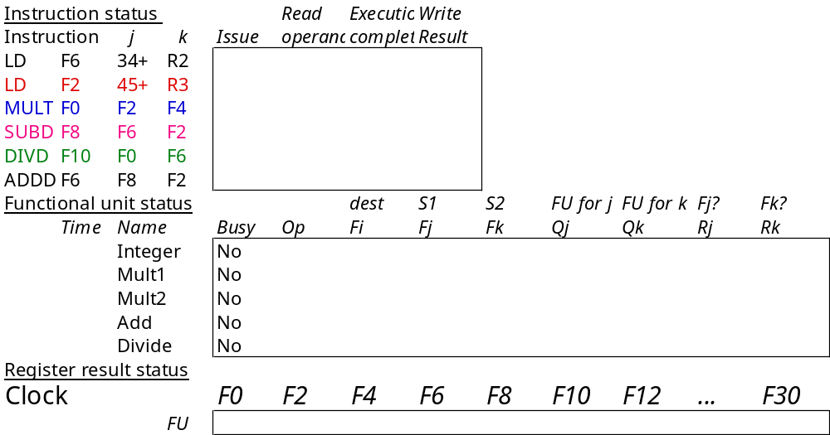
Scoreboard Example

Slide 31
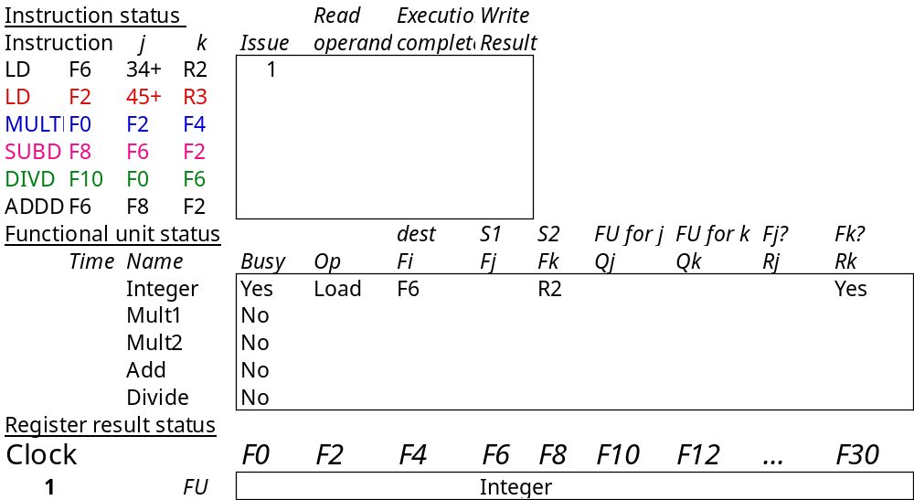
Scoreboard Example Cycle 1

Slide 32

Scoreboard Example Cycle 2
Issue 2nd LD?

Slide 33
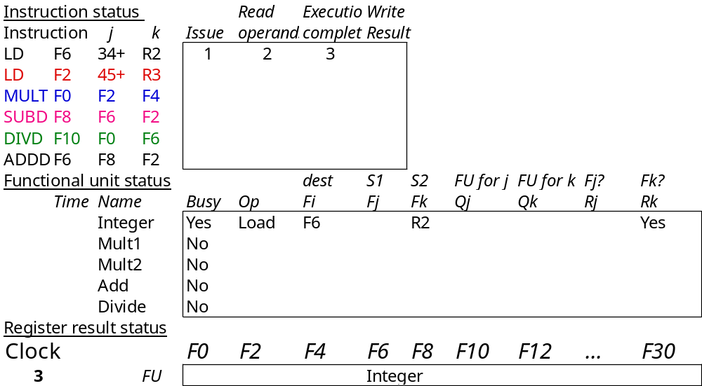
Scoreboard Example Cycle 3
Issue MULT?

Slide 34

Scoreboard Example Cycle 4

Slide 35
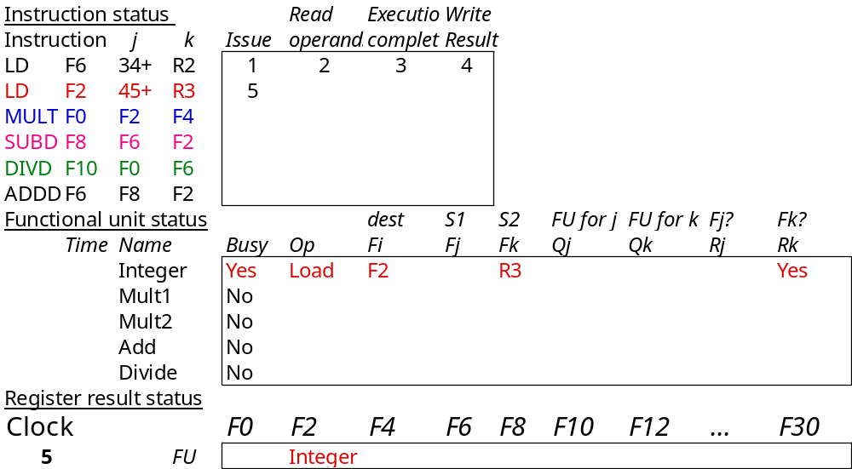
Scoreboard Example Cycle 5

Slide 36
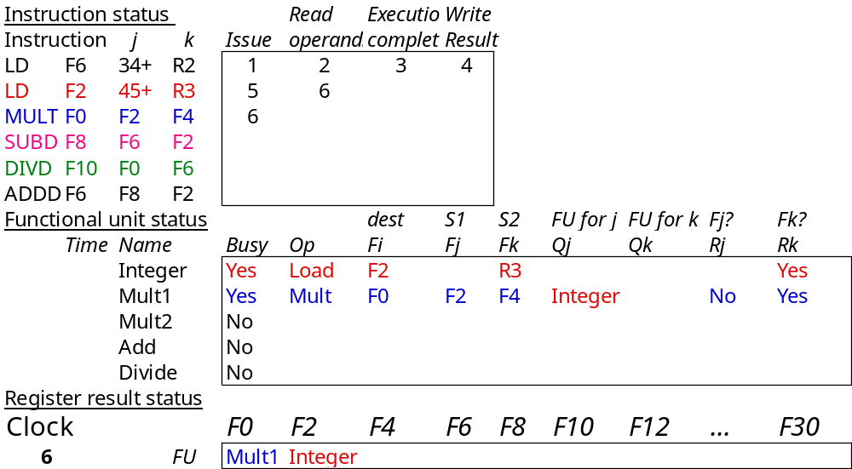
Scoreboard Example Cycle 6

Slide 37
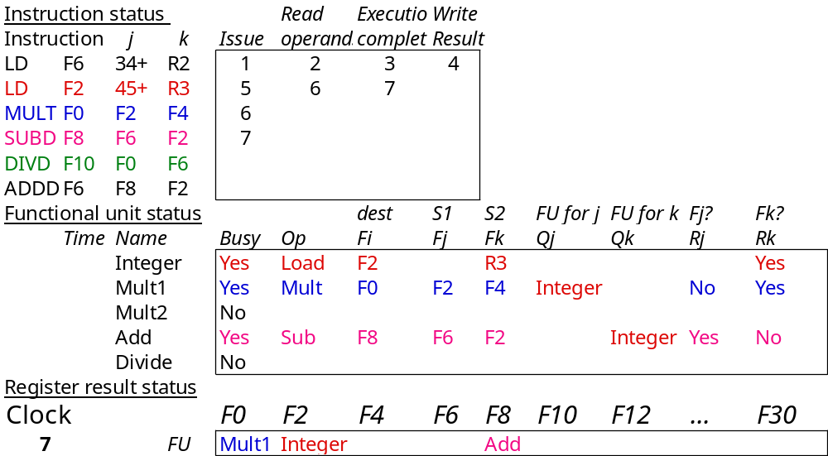
Scoreboard Example Cycle 7
Read multiply operands?

Slide 38
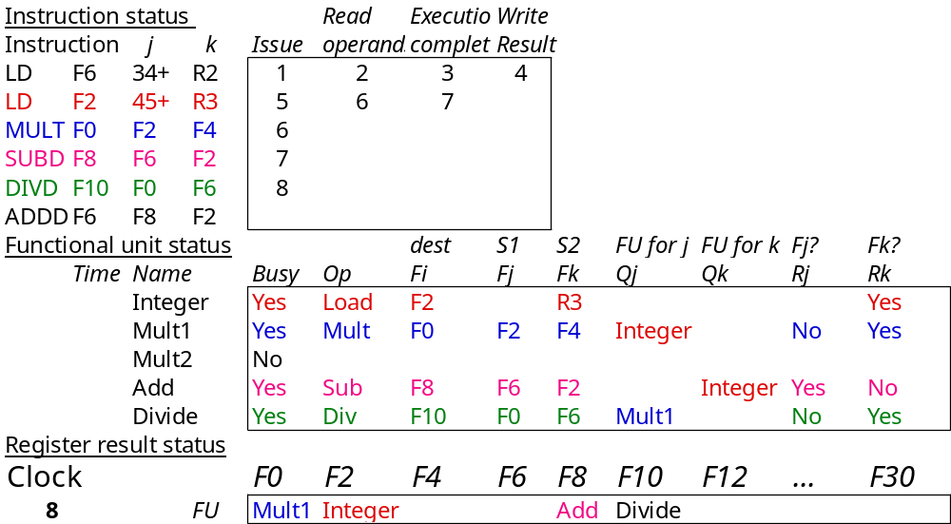
Scoreboard Example Cycle 8a

Slide 39
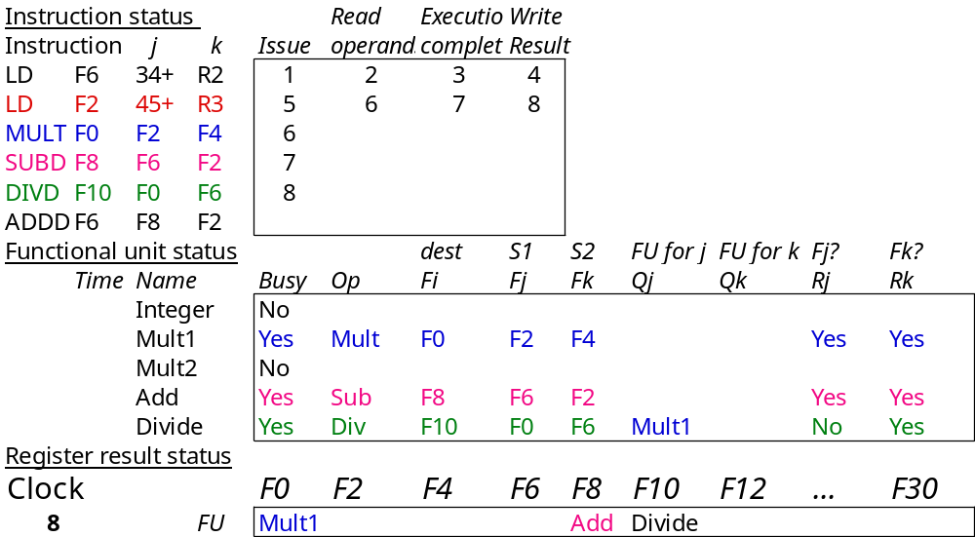
Scoreboard Example Cycle 8b

Slide 40
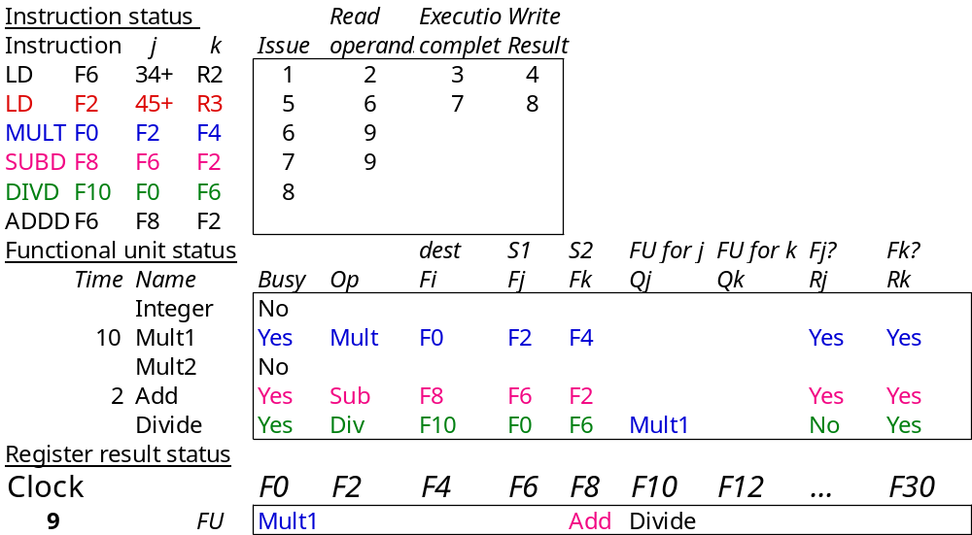
Scoreboard Example Cycle 9
Read operands for MULT & SUBD? Issue ADDD?

Slide 41
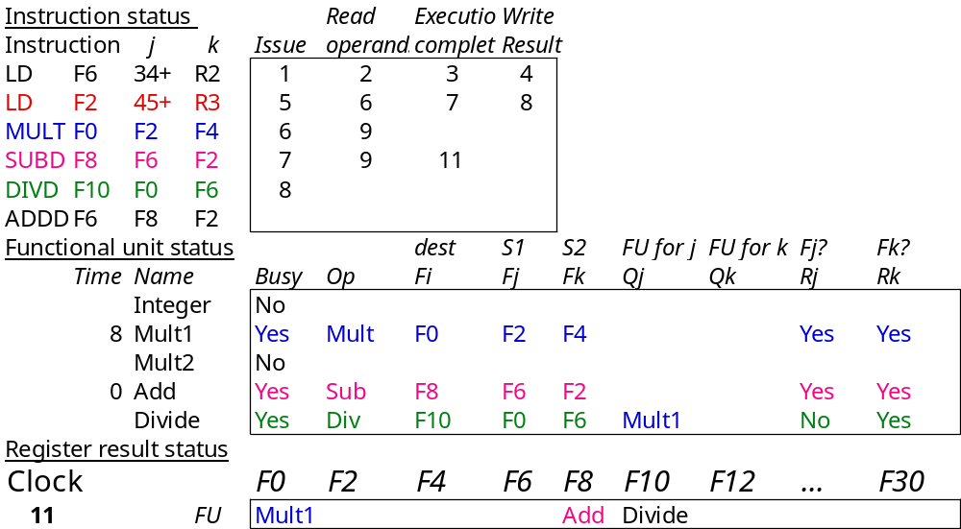
Scoreboard Example Cycle 11

Slide 42
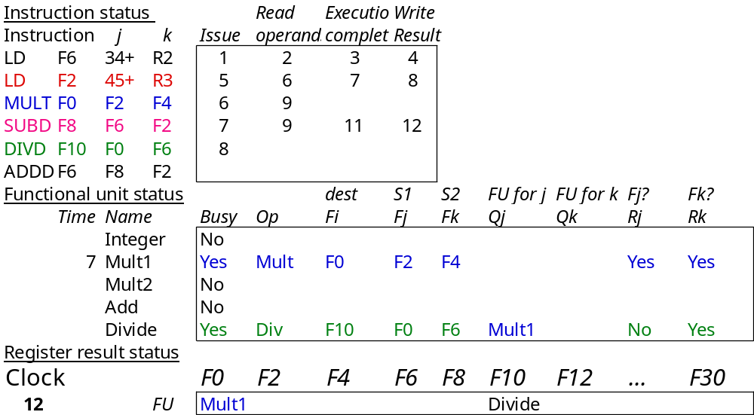
Scoreboard Example Cycle 12
Read operands for DIVD?

Slide 43
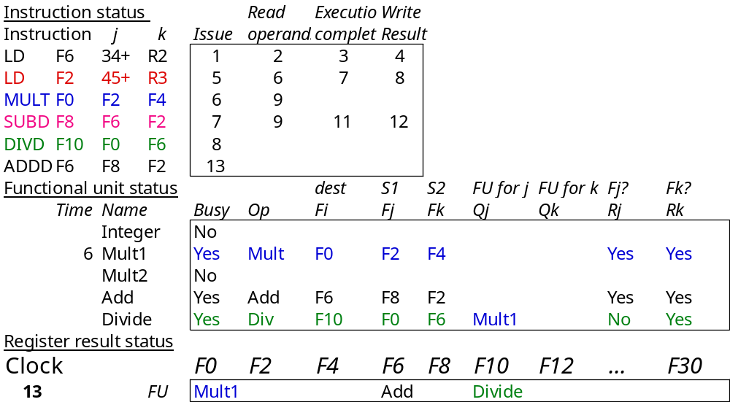
Scoreboard Example Cycle 13

Slide 44
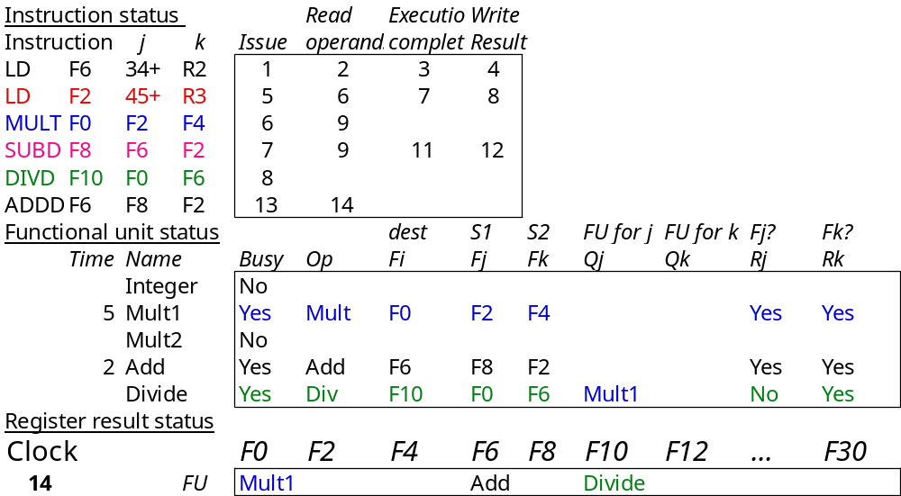
Scoreboard Example Cycle 14

Slide 45
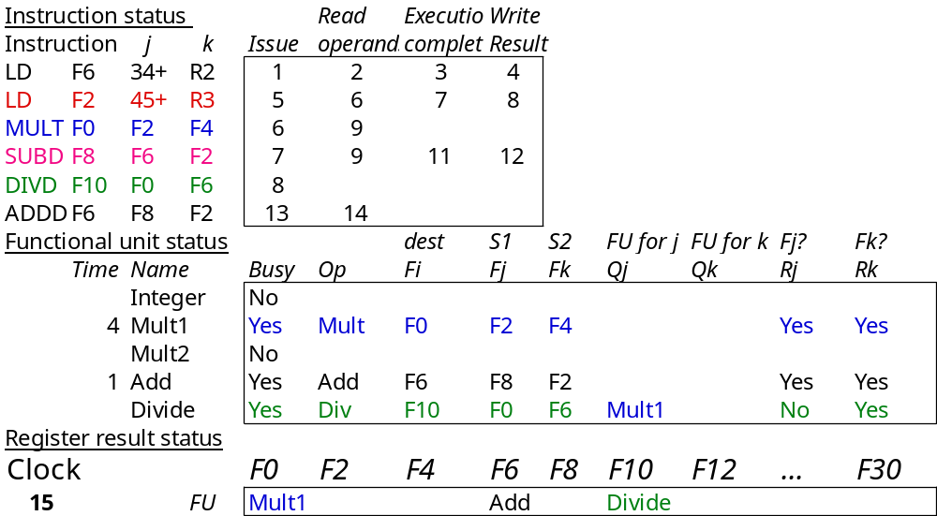
Scoreboard Example Cycle 15

Slide 46
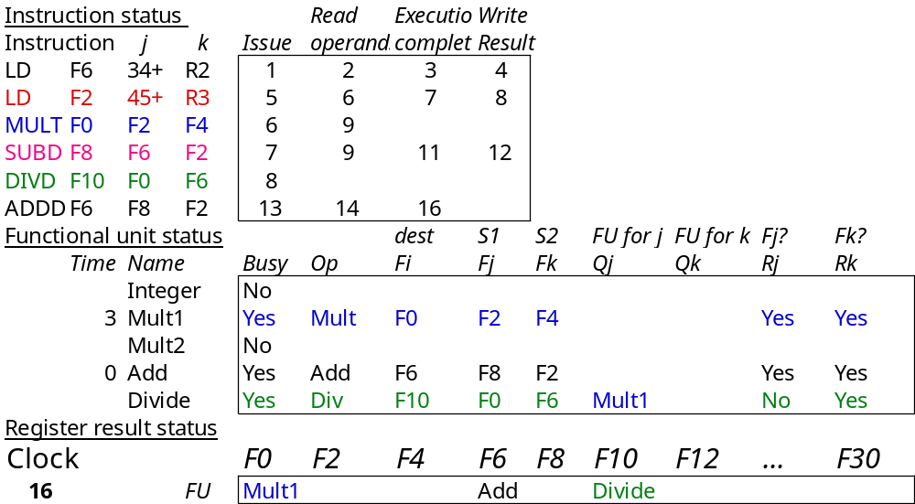
Scoreboard Example Cycle 16

Slide 47
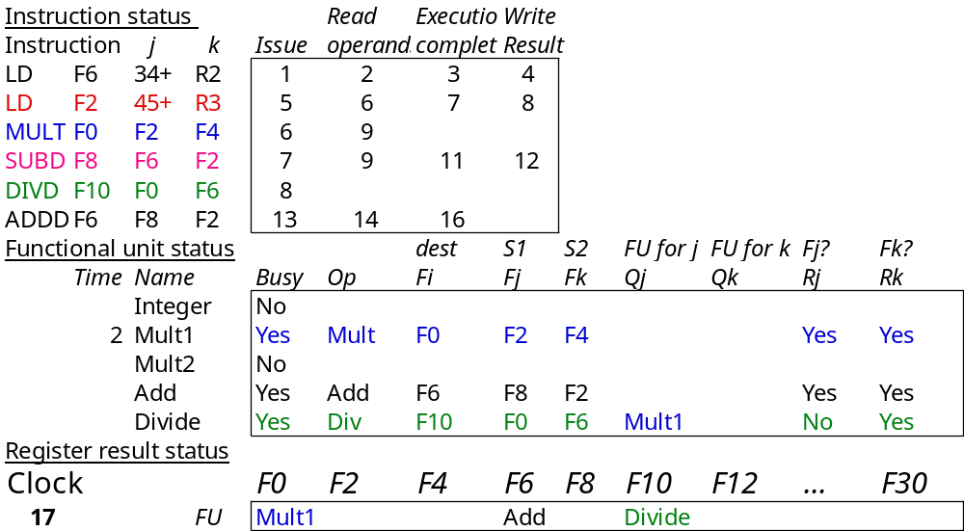
Scoreboard Example Cycle 17
Write result of ADDD?

Slide 48

Scoreboard Example Cycle 18

Slide 49
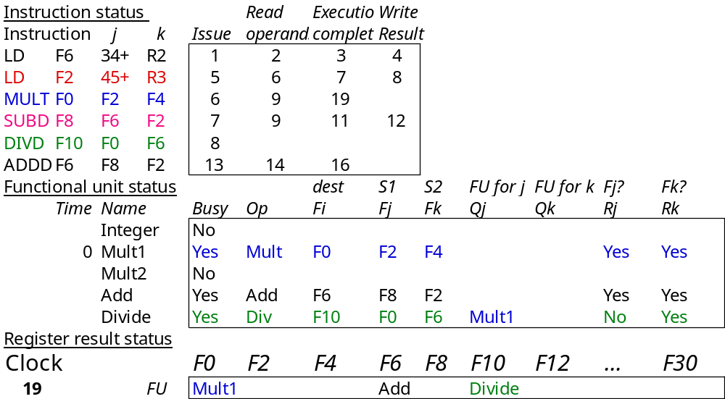
Scoreboard Example Cycle 19

Slide 50
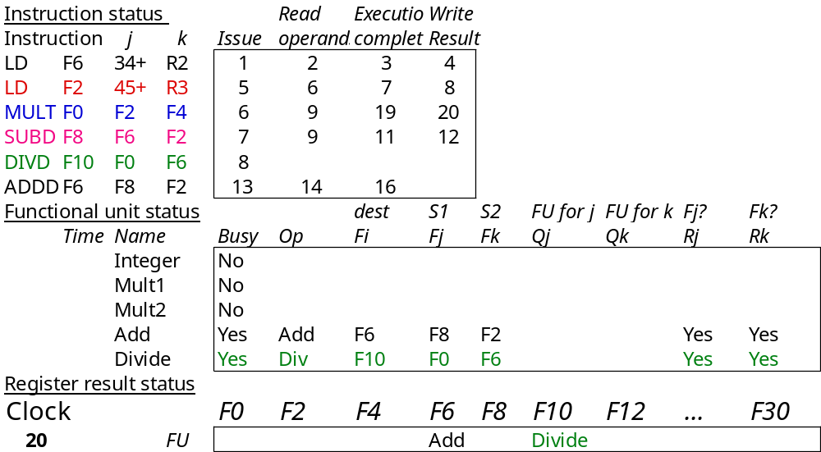
Scoreboard Example Cycle 20

Slide 51

Scoreboard Example Cycle 21

Slide 52
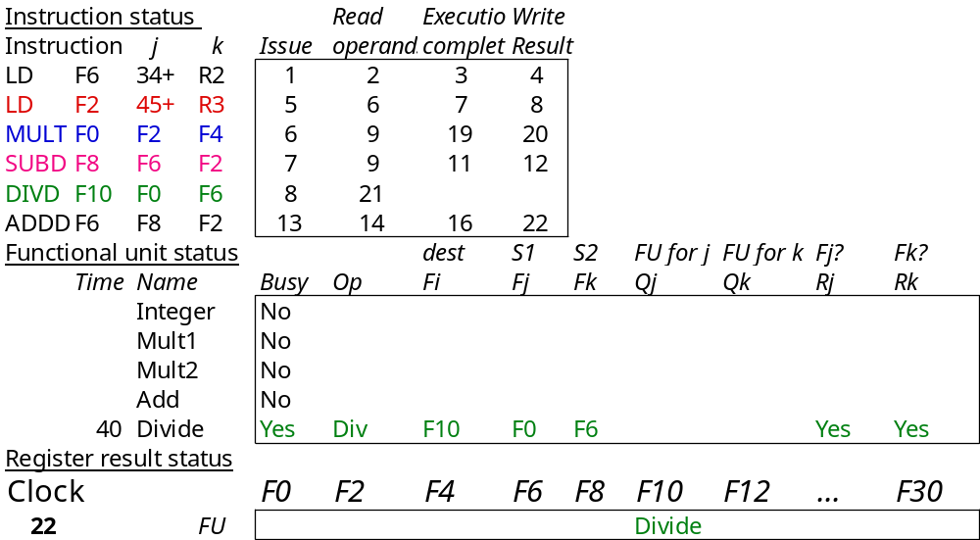
Scoreboard Example Cycle 22

Slide 53
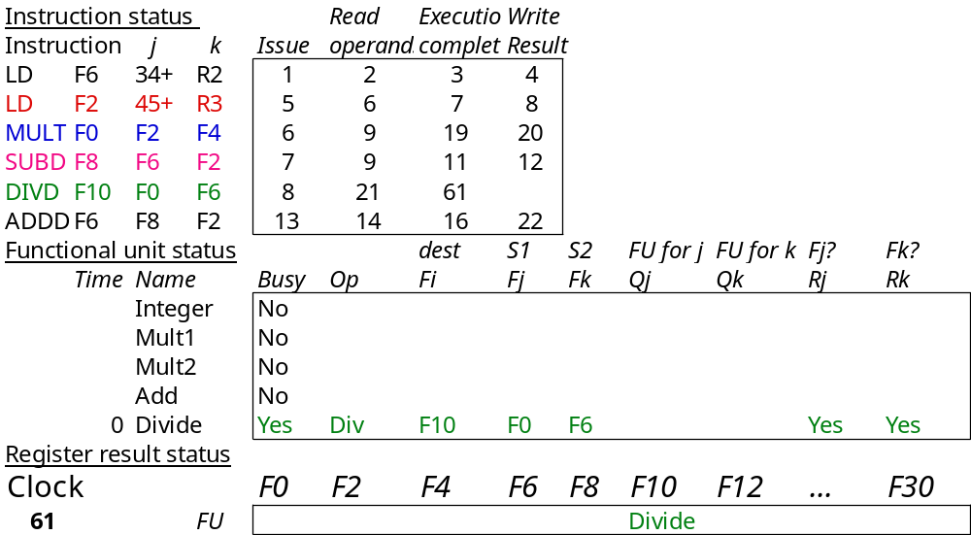
Scoreboard Example Cycle 61

Slide 54
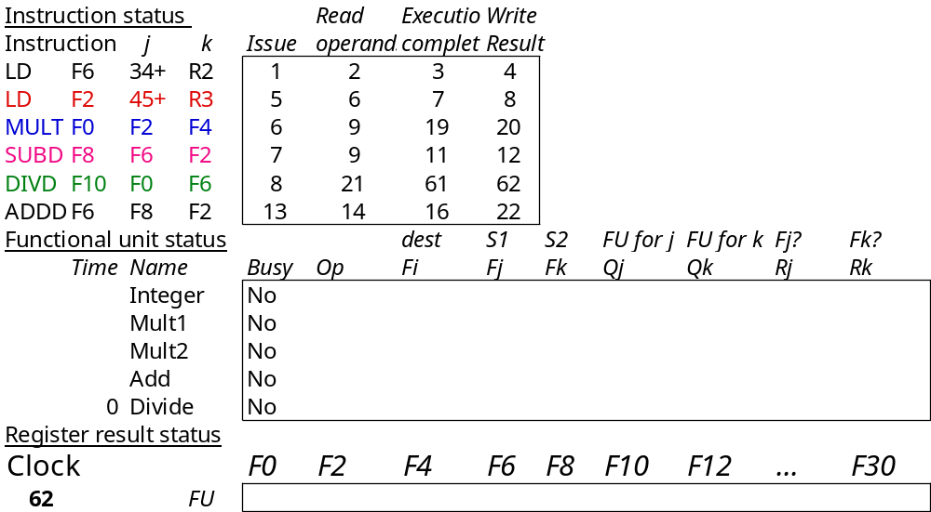
Scoreboard Example Cycle 62

Slide 55
CDC 6600 Scoreboard
Speedup 1.7 from compiler; 2.5 by hand
BUT slow memory (no cache) limits benefit
Limitations of 6600 scoreboard:
  No forwarding hardware
  Limited to instructions in basic block (small window)
  Small number of functional units (structural hazards), especailly integer/load store units
  Do not issue on structural hazards
  Wait for WAR hazards
  Prevent WAW hazards

Slide 56
Summary
Instruction Level Parallelism (ILP) in SW or HW
Loop level parallelism is easiest to see
SW parallelism dependencies defined for program, hazards if HW cannot resolve
SW dependencies/compiler sophistication determine if compiler can unroll loops
  Memory dependencies hardest to determine
HW exploiting ILP
  Works when can’t know dependence at compile time
  Code for one machine runs well on another
Key idea of Scoreboard: Allow instructions behind stall to proceed (Decode => Issue instr & read operands)
  Enables out-of-order execution => out-of-order completion
  ID stage checked both for structural

Slide 57
Review: Summary
ILP in SW or HW
Loop level parallelism is easiest to see
SW parallelism dependencies defined for program, hazards if HW cannot resolve
SW dependencies/compiler sophistication determine if compiler can unroll loops
  Memory dependencies hardest to determine
HW exploiting ILP
  Works when can’t know dependence at run time
  Code for one machine runs well on another
Key idea of Scoreboard: Allow instructions behind stall to proceed (Decode => Issue instr & read operands)
  Enables out-of-order execution => out-of-order completion
  ID stage checked both for structural

Slide 58
Review: Three Parts of the Scoreboard
1. Instruction status—which of 4 steps the instruction is in
2. Functional unit status—Indicates the state of the functional unit (FU). 9 fields for each functional unit
Busy—Indicates whether the unit is busy or not
Op—Operation to perform in the unit (e.g., + or –)
Fi—Destination register
Fj, Fk—Source-register numbers
Qj, Qk—Functional units producing source registers Fj, Fk
Rj, Rk—Flags indicating when Fj, Fk are ready
3. Register result status—Indicates which functional unit will write each register, if one exists. Blank when no pending instructions will write that register
Notes:
What you might have thought
1. 4 stages of instruction executino
2.Status of FU: Normal things to keep track of (RAW & structura for busyl):
Fi from instruction format of the mahine (Fi is dest)
Add unit can Add or Sub
Rj, Rk - status of registers (Yes means ready)
Qj,Qk - If a no in Rj, Rk, means waiting for a FU to write result; Qj, Qk means wihch FU waiting for it
3.Status of register result (WAW &WAR)s:
which FU is going to write into registers
Scoreboard on 6600 = size of FU
6.7, 6.8, 6.9, 6.12, 6.13, 6.16, 6.17
FU latencies: Add 2, Mult 10, Div 40 clocks

Slide 59
Review: Scoreboard Example Cycle 3
Issue MULT? No, stall on structural hazard

Slide 60
Review: Scoreboard Example Cycle 9
Read operands for MULT & SUBD? Issue ADDD?

Slide 61
Review: Scoreboard Example Cycle 17
Write result of ADDD? No, WAR hazard

Slide 62
Review: Scoreboard Example Cycle 62
In-order issue; out-of-order execute & commit

Slide 63
Review: Scoreboard Summary
Limitations of 6600 scoreboard
  No forwarding (First write regsiter then read it)
  Limited to instructions in basic block
  (small window)
  Number of functional units(structural hazards)
  Wait for WAR hazards
  Prevent WAW hazards

Slide 64
Another Dynamic Algorithm: Tomasulo Algorithm
For IBM 360/91 about 3 years after CDC 6600 (1966)
Goal: High Performance without special compilers
Why Study? lead to Alpha 21264, HP 8000, MIPS 10000, Pentium II, PowerPC 604, …

Slide 65
Tomasulo Algorithm vs. Scoreboard
Control & buffers distributed with Function Units (FU) vs. centralized in scoreboard;
  FU buffers called “reservation stations”; have pending operands
Registers in instructions replaced by values or pointers to reservation stations(RS); called register renaming ;
  avoids WAR, WAW hazards
  More reservation stations than registers, so can do optimizations compilers can’t
Results to FU from RS, not through registers, over Common Data Bus that broadcasts results to all FUs
Load and Stores treated as FUs with RSs as well

Slide 66
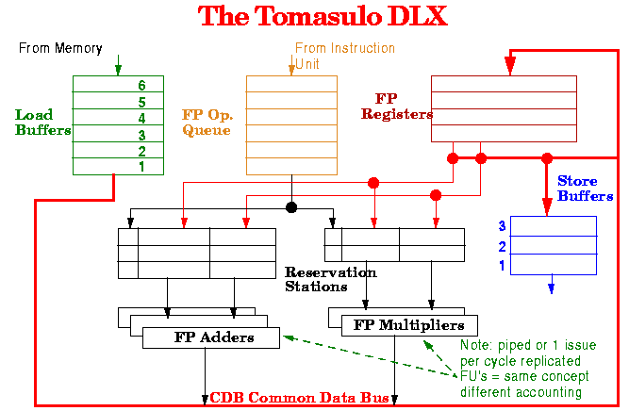

Slide 67
Reservation Station Components
Op—Operation to perform in the unit (e.g., + or –)
Vj, Vk—Value of Source operands
  Store buffers has V field, result to be stored
Qj, Qk—Reservation stations producing source registers (value to be written)
  Note: No ready flags as in Scoreboard; Qj,Qk=0 => ready
  Store buffers only have Qi for RS producing result
Busy—Indicates reservation station or FU is busy
Register result status—Indicates which functional unit will write each register, if one exists. Blank when no pending instructions that will write that register.
Notes:
What you might have thought
1. 4 stages of instruction executino
2.Status of FU: Normal things to keep track of (RAW & structura for busyl):
Fi from instruction format of the mahine (Fi is dest)
Add unit can Add or Sub
Rj, Rk - status of registers (Yes means ready)
Qj,Qk - If a no in Rj, Rk, means waiting for a FU to write result; Qj, Qk means wihch FU waiting for it
3.Status of register result (WAW &WAR)s:
which FU is going to write into registers
Scoreboard on 6600 = size of FU
6.7, 6.8, 6.9, 6.12, 6.13, 6.16, 6.17
FU latencies: Add 2, Mult 10, Div 40 clocks

Slide 68
Three Stages of Tomasulo Algorithm
1. Issue—get instruction from FP Op Queue
  If reservation station free (no structural hazard),
  control issues instr & sends operands (renames registers).
2. Execution—operate on operands (EX)
  When both operands ready then execute;
  if not ready, watch Common Data Bus for result
3. Write result—finish execution (WB)
  Write on Common Data Bus to all awaiting units;
  mark reservation station available
Normal data bus: data + destination (“go to” bus)
Common data bus: data + source (“come from” bus)
  64 bits of data + 4 bits of Functional Unit source address
  Write if matches expected Functional Unit (produces result)
  Does the broadcast

Slide 69
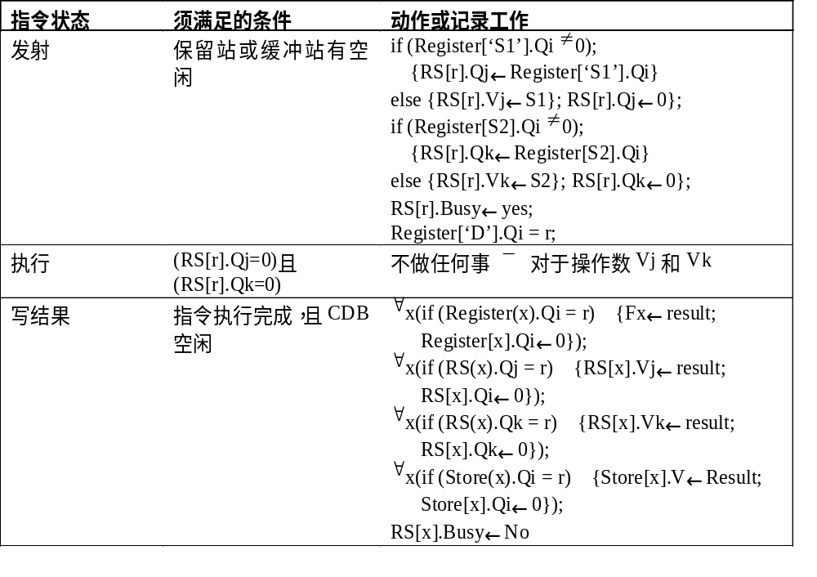

Slide 70
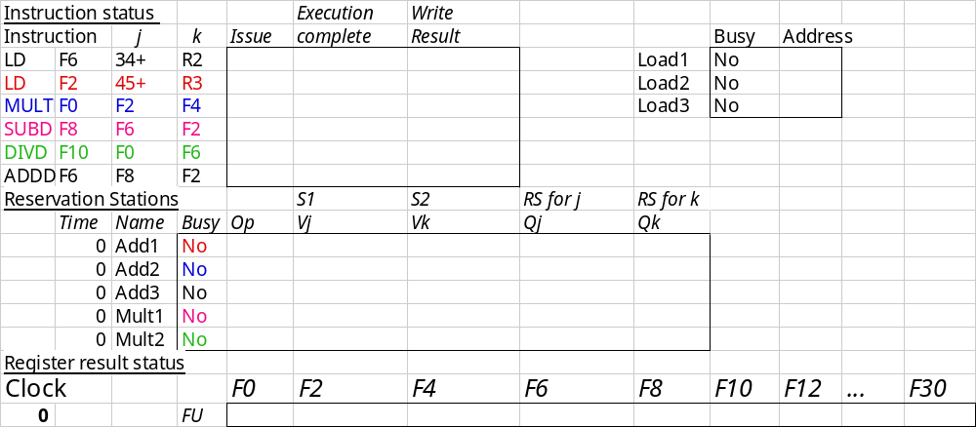
Tomasulo Example Cycle 0

Slide 71
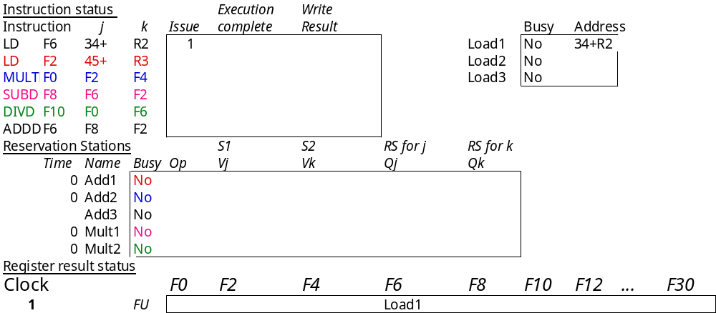
Tomasulo Example Cycle 1
Yes

Slide 72
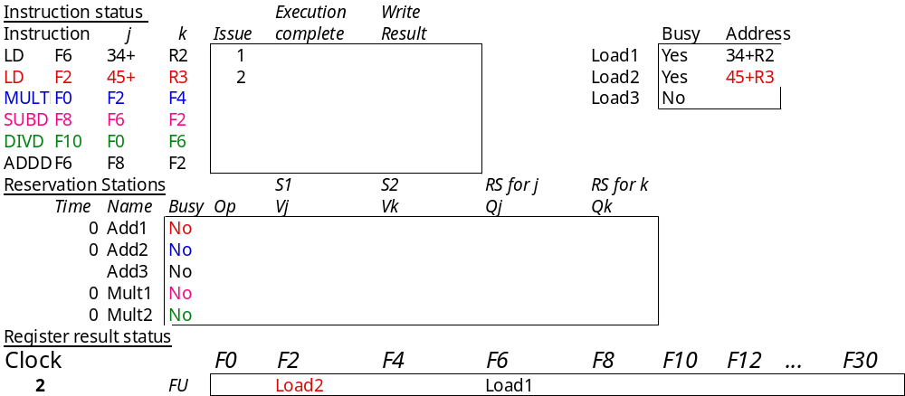
Tomasulo Example Cycle 2
Note: Unlike 6600, can have multiple loads outstanding

Slide 73
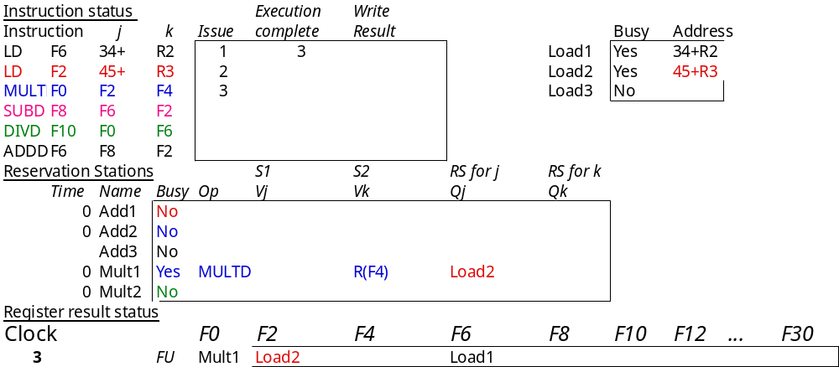
Tomasulo Example Cycle 3
Note: registers names are removed (“renamed”) in Reservation Stations; MULT issued vs. scoreboard
Load1 completing; what is waiting for Load1?

Slide 74
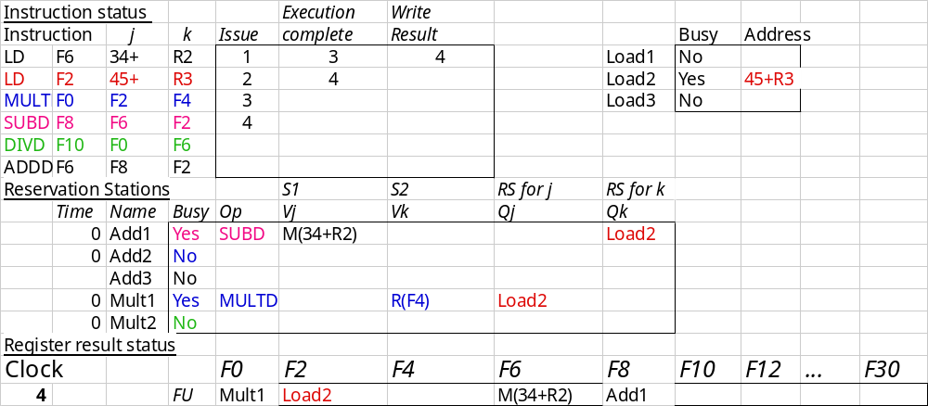
Tomasulo Example Cycle 4
Load2 completing; what is waiting for it?

Slide 75
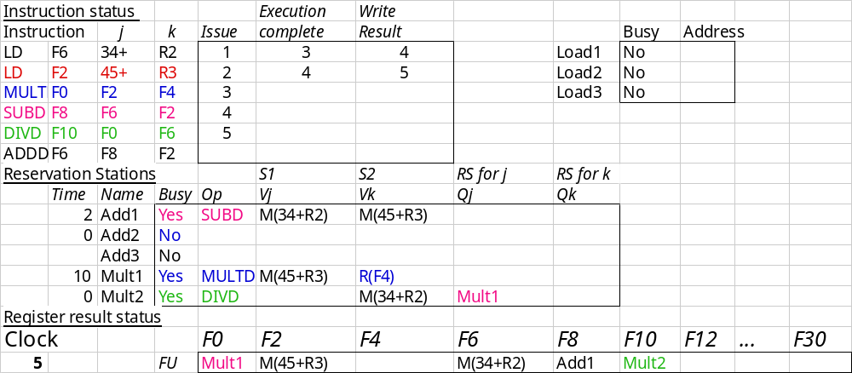
Tomasulo Example Cycle 5

Slide 76
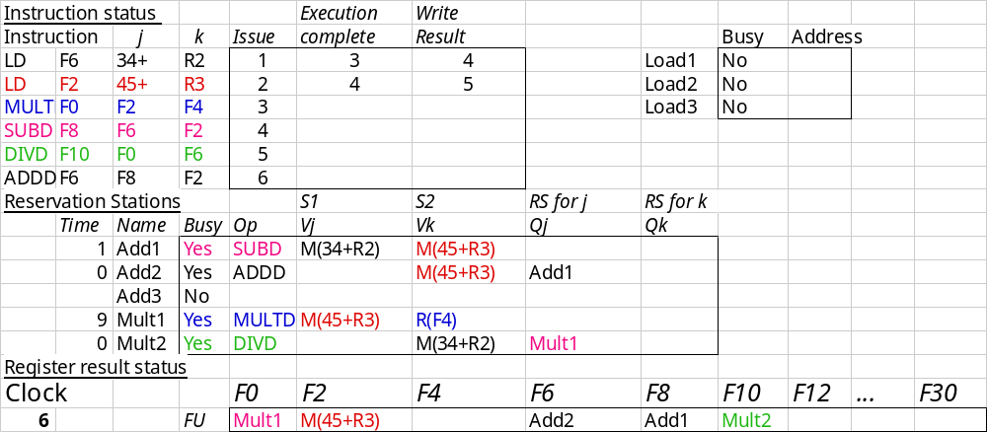
Tomasulo Example Cycle 6
Issue ADDD here vs. scoreboard?

Slide 77

Tomasulo Example Cycle 7
Add1 completing; what is waiting for it?

Slide 78
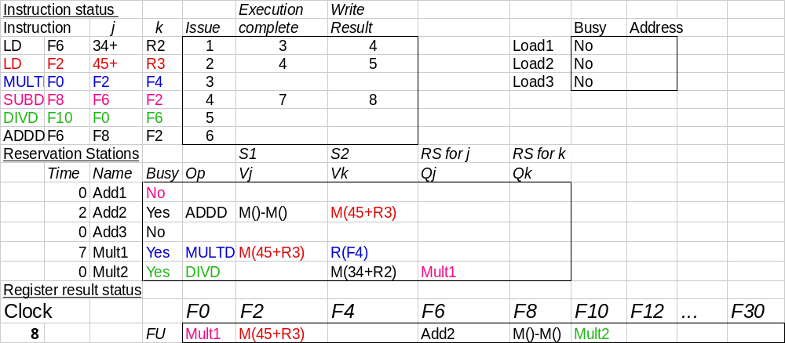
Tomasulo Example Cycle 8

Slide 79
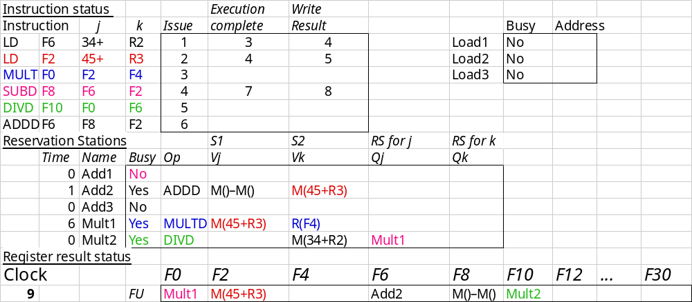
Tomasulo Example Cycle 9

Slide 80
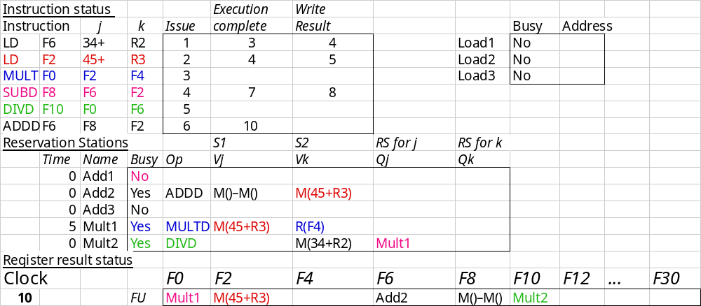
Tomasulo Example Cycle 10
Add2 completing; what is waiting for it?

Slide 81
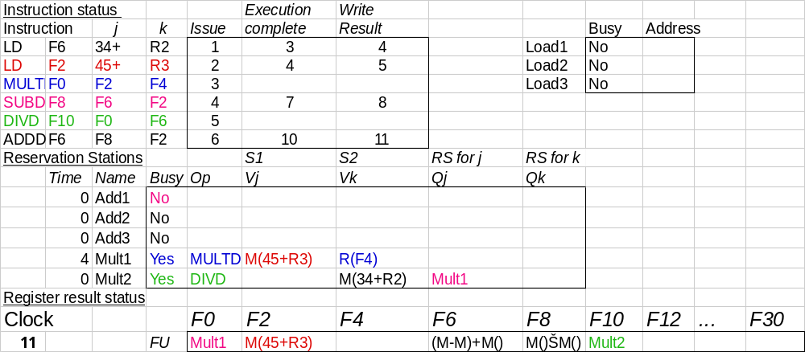
Tomasulo Example Cycle 11
Write result of ADDD here vs. scoreboard?

Slide 82
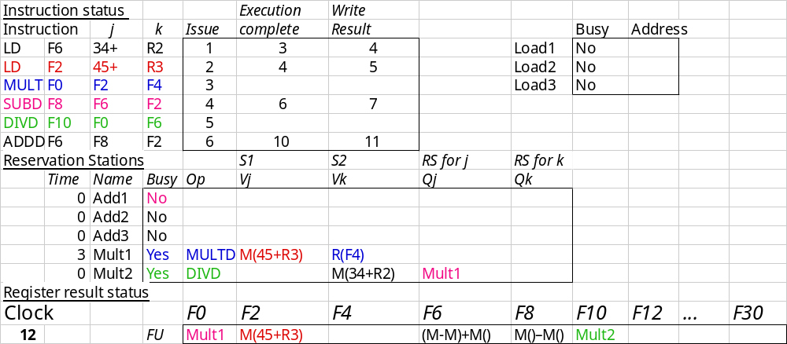
Tomasulo Example Cycle 12
Note: all quick instructions complete already

Slide 83

Tomasulo Example Cycle 13

Slide 84

Tomasulo Example Cycle 14

Slide 85
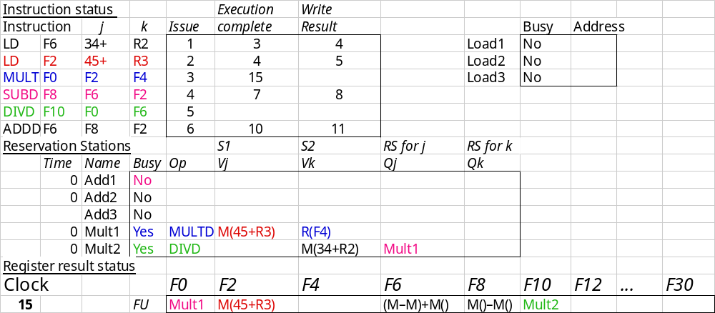
Tomasulo Example Cycle 15
Mult1 completing; what is waiting for it?

Slide 86
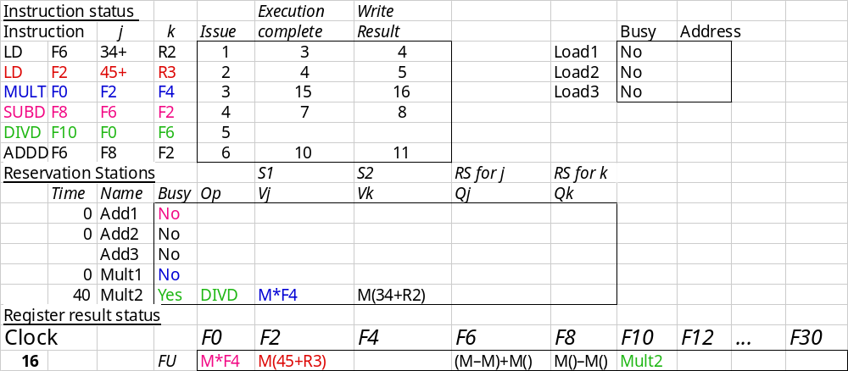
Tomasulo Example Cycle 16
Note: Just waiting for divide

Slide 87
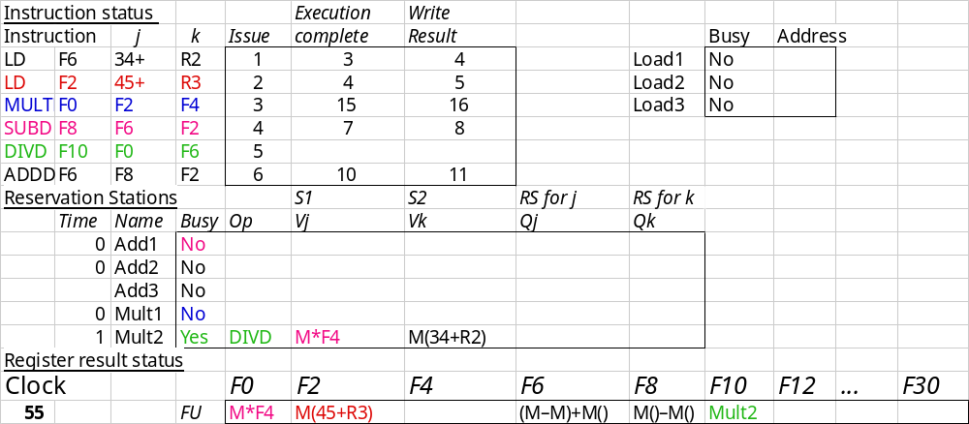
Tomasulo Example Cycle 55

Slide 88
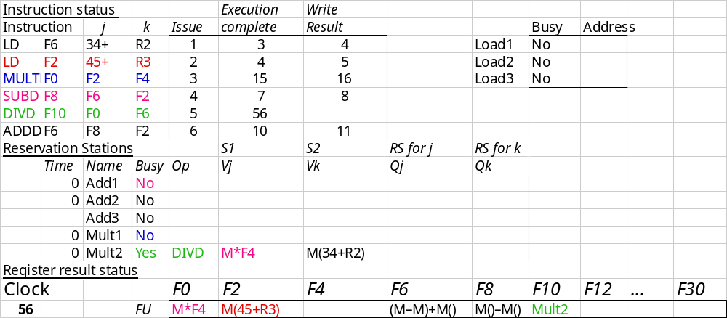
Tomasulo Example Cycle 56
Mult 2 completing; what is waiting for it?

Slide 89
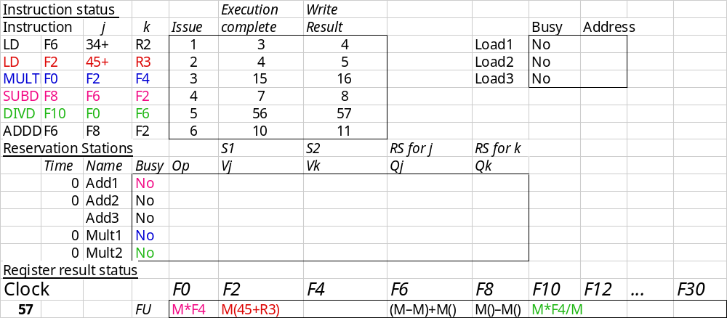
Tomasulo Example Cycle 57
Again, in-oder issue,
out-of-order execution, completion

Slide 90
Compare to Scoreboard Cycle 62
Why takes longer on Scoreboard/6600?

Slide 91
Tomasulo v. Scoreboard
(IBM 360/91 v. CDC 6600)
Pipelined Functional Units Multiple Functional Units
(6 load, 3 store, 3 +, 2 x/÷) (1 load/store, 1 + , 2 x, 1 ÷)
window size: ≤ 14 instructions ≤ 5 instructions
No issue on structural hazard same
WAR: renaming avoids stall completion
WAW: renaming avoids stall completion
Broadcast results from FU Write/read registers
Control: reservation stations central scoreboard

Slide 92
Tomasulo Drawbacks
Complexity
  delays of 360/91, MIPS 10000, IBM 620?
Many associative stores (CDB) at high speed
Performance limited by Common Data Bus
  Multiple CDBs => more FU logic for parallel assoc stores

Slide 93
Tomasulo Loop Example
Loop: LD F0 0 R1
MULTD F4 F0 F2
SD F4 0 R1
SUBI R1 R1 #8
BNEZ R1 Loop
Assume Multiply takes 4 clocks
Assume first load takes 8 clocks (cache miss?), second load takes 4 clocks (hit)
To be clear, will show clocks for SUBI, BNEZ
Reality, integer instructions ahead

Slide 94
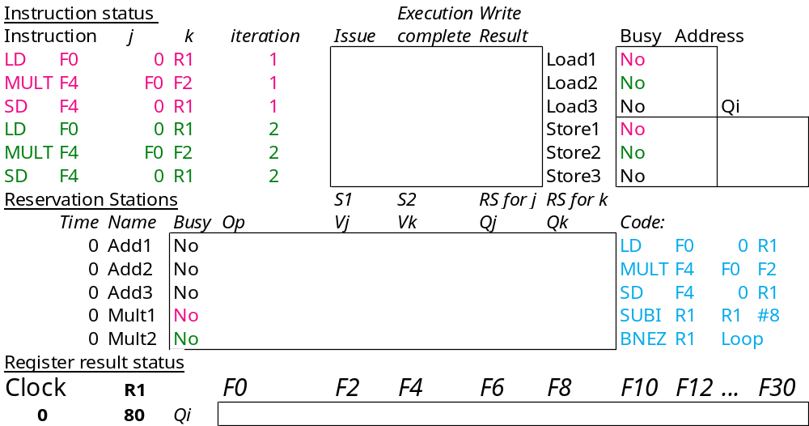
Loop Example Cycle 0

Slide 95
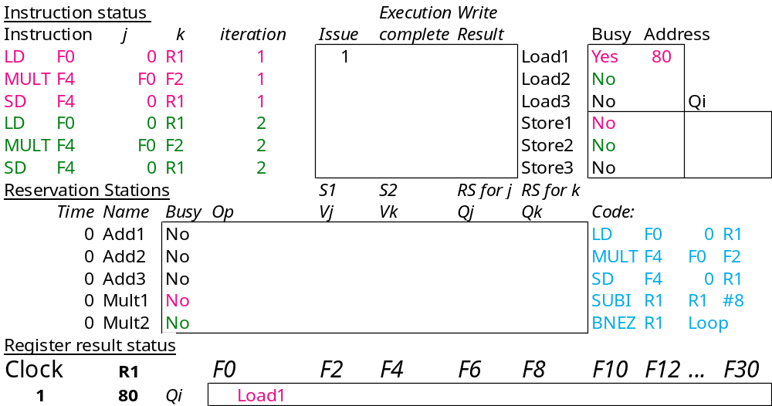
Loop Example Cycle 1

Slide 96
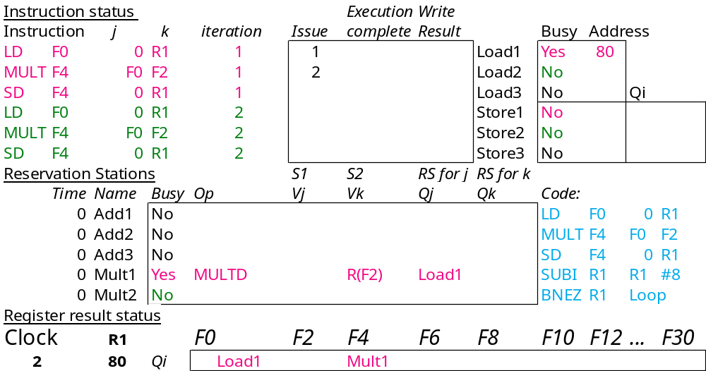
Loop Example Cycle 2

Slide 97
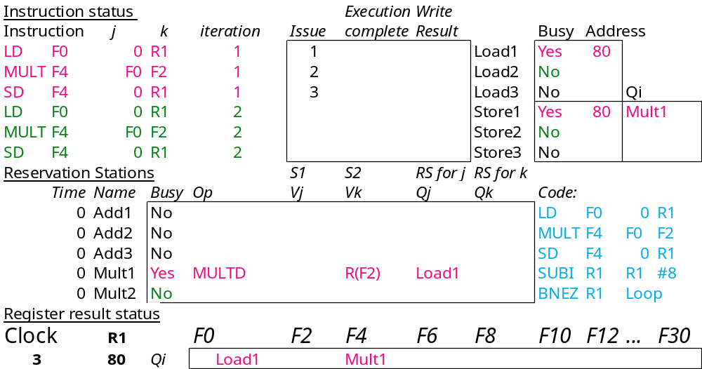
Loop Example Cycle 3
Note: MULT1 has no registers names in RS

Slide 98

Loop Example Cycle 4

Slide 99

Loop Example Cycle 5

Slide 100
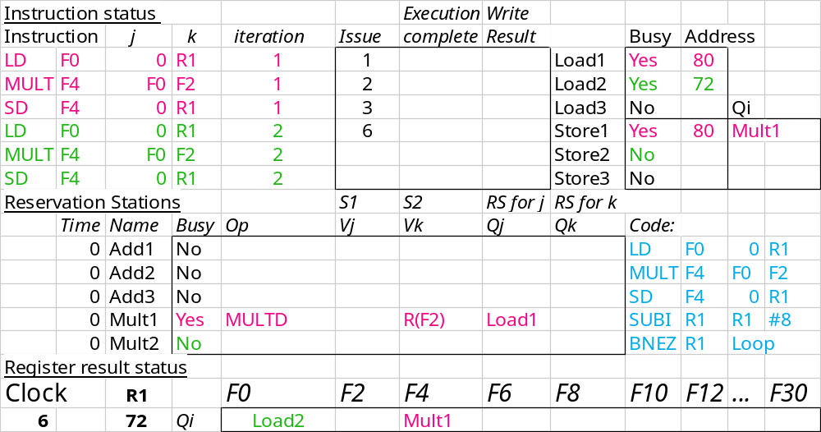
Loop Example Cycle 6
Note: F0 never sees Load1 result

Slide 101
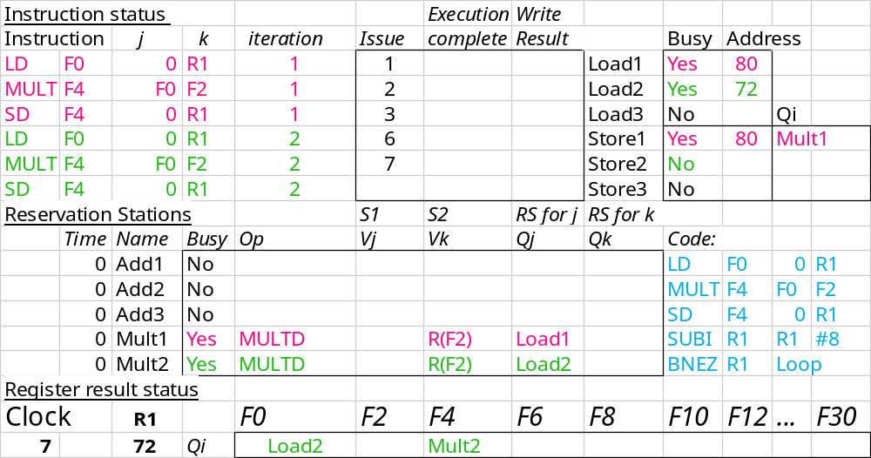
Loop Example Cycle 7
Note: MULT2 has no registers names in RS

Slide 102
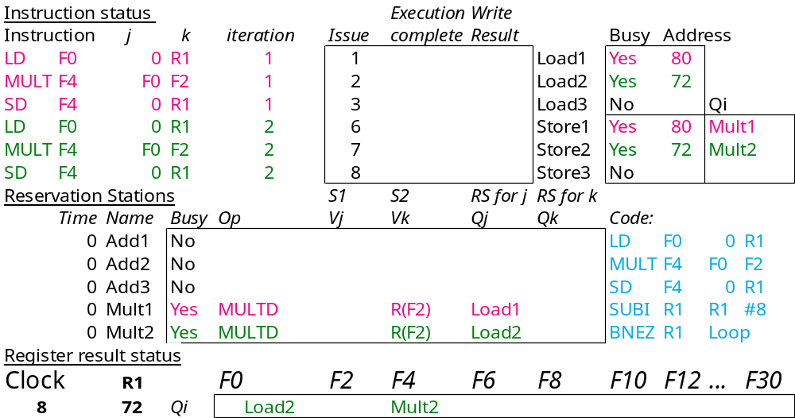
Loop Example Cycle 8

Slide 103
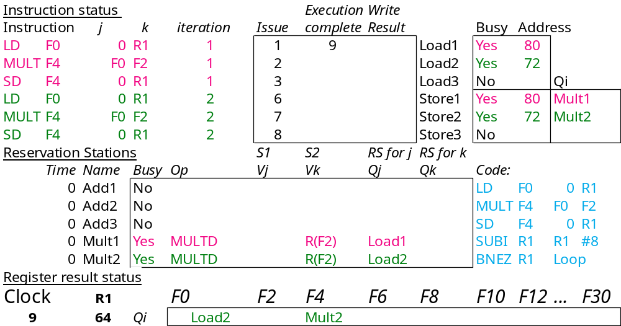
Loop Example Cycle 9
Load1 completing; what is waiting for it?

Slide 104
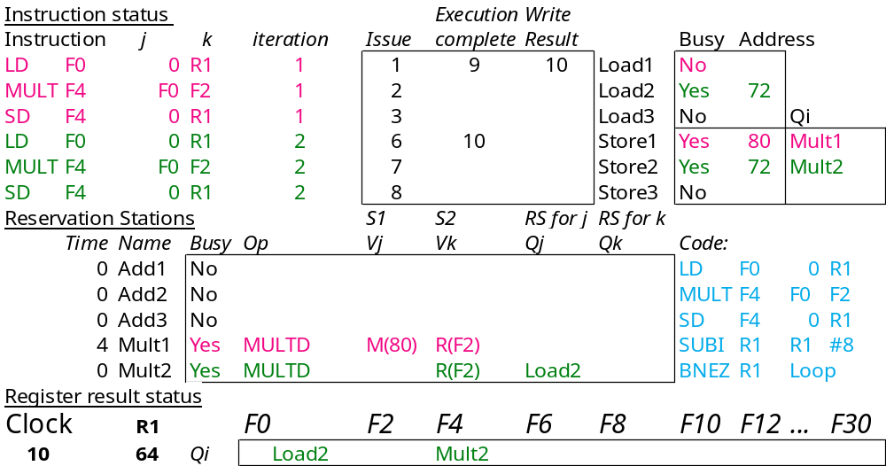
Loop Example Cycle 10
Load2 completing; what is waiting for it?

Slide 105
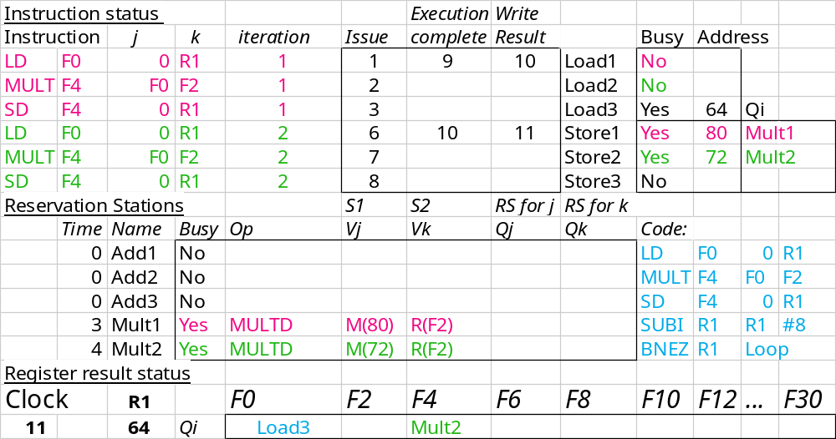
Loop Example Cycle 11

Slide 106

Loop Example Cycle 12

Slide 107

Loop Example Cycle 13

Slide 108

Loop Example Cycle 14
Mult1 completing; what is waiting for it?

Slide 109

Loop Example Cycle 15
Mult2 completing; what is waiting for it?

Slide 110

Loop Example Cycle 16

Slide 111

Loop Example Cycle 17

Slide 112

Loop Example Cycle 18

Slide 113

Loop Example Cycle 19

Slide 114

Loop Example Cycle 20

Slide 115

Loop Example Cycle 21
＝？
If load addr=store addr. We must stop load and wait until the store buffer get a value

Slide 116
Tomasulo Summary
Reservations stations: renaming to larger set of registers + buffering source operands
  Prevents registers as bottleneck
  Avoids WAR, WAW hazards of Scoreboard
  Allows loop unrolling in HW
Not limited to basic blocks
(integer units gets ahead, beyond branches)
Helps cache misses as well
Lasting Contributions
  Dynamic scheduling
  Register renaming
  Load/store disambiguation
360/91 descendants are Pentium II; PowerPC 604; MIPS R10000; HP-PA 8000; Alpha 21264

